Slide 1
Stationery Inventory System - Logic University
UI Walkthrough - Store functions
Revision 1
Notes:
Android features :
Disbursement List
Consolidated orders/request
Access stock card
Access adjustment voucher

Slide 2
Page No. | Screen Title
3 | Login Page
4 | Home Page
5 | Stationery Catalogue for Department
6 | Stationery Catalogue for Store
7 | Edit Stationery Catalogue
8 | Stock Card
9 | Supplier List (for Store Clerk and Store Supervisor)
10 | Supplier List (for Store Manager)
11 | Supplier List (for Store Manager)
12 | Department List (for Store Clerk)
13 | Search for Purchase Order Page
14, 15 | Detailed PO view Page
16 | Approve/Reject/Cancel PO view Page
17 | Purchase Order Creation Page
18 | Search for Item Page
19 | View Disbursement List Page
20 | Disbursement List Details Page
Page No. | Screen Title
21 | Search Inventory Retrieval Forms Page
22 | Detailed Inventory Retrieval Form Page
23 | Edit Retrieval Form Page
24 | Inventory Adjustment Voucher
25 | Approve Adjustment Request - Store Supervisor
26 | Approve Adjustment Request - Store Manager
27 | Inventory Approval Status
28 | Low Stock Status Report
29 | Inventory Status Report
30 | Update Transaction History
31 | Stationery Requisition Trends
32 | Department Requisition Trends
33, 34 | Consolidated Stationary Request-store Clerk

Slide 3
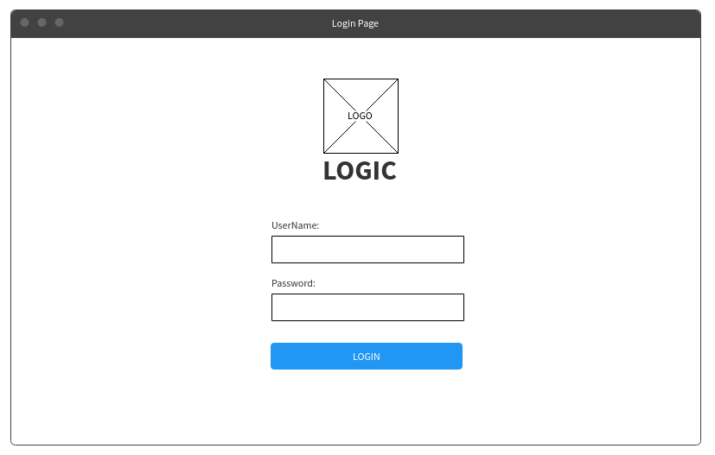
Login Page
Features/Business Workflow :
This will be the login page for Logic University User.

Slide 4
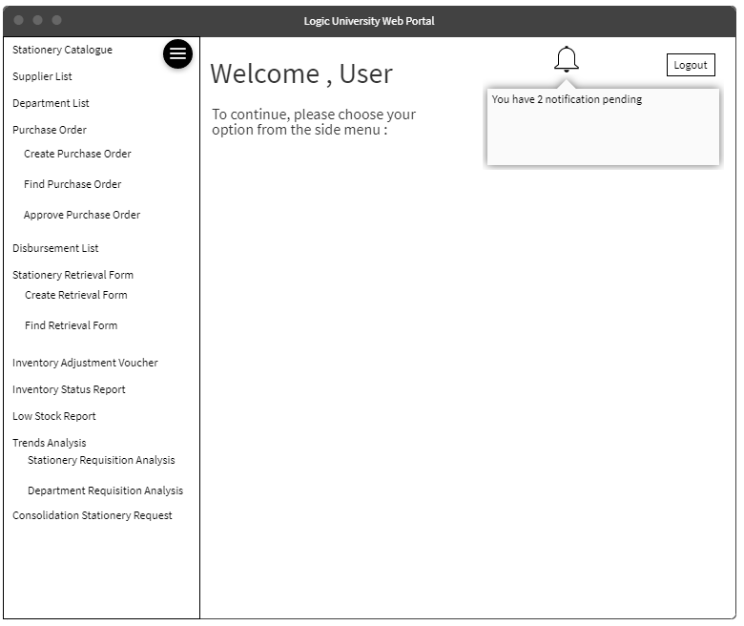
Home Page
Features/Business Workflow :
1. After login, the user will be looking at the homepage. It has a side-bar menu, which comprise lists of different functionalities of the system. Some of the functionalities will only be restricted to some users, for example, Approve Purchase Order will only be accessed by the store supervisor/store manager for approval
2. Depending on who log in to the page, the notification will display the pending activities, such as re-stock low level item, or purchase order pending for approval.
3. If we click on one of the pending activities, it will lead to the page that invokes the pending activities. (For example, a click on pending purchase order approval notification will lead to the purchase order approval page).

Slide 5
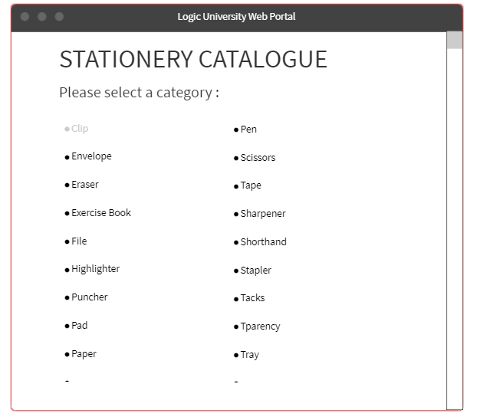
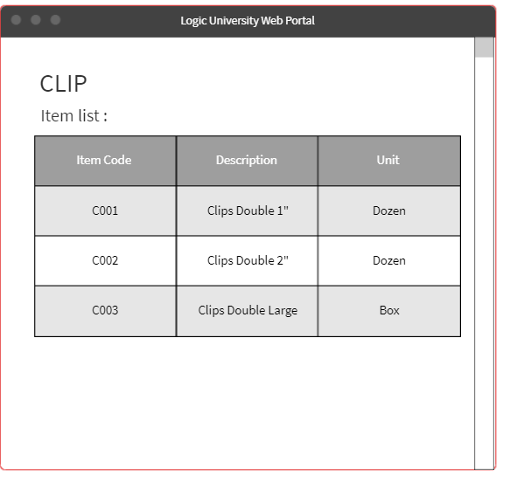
Stationery Catalogue for Department
Features/Business Workflow :
When Department staff needs a reference for making a stationery request, they will have the access to the stationery catalogue.(Note that there is no menu button and user being indicated, since this catalogue is merely for Department reference)
1. Select the stationery catalogue option.
2. Click on the stationery category (Clip, paper, pen etc).
3. Department staff will be able to view the list of items of that category.
Notes:
This is stationery catalogue for department (they only need to know what the item code, description and unit of measurement).
Need to create both pages, specifically for department side to refer

Slide 6
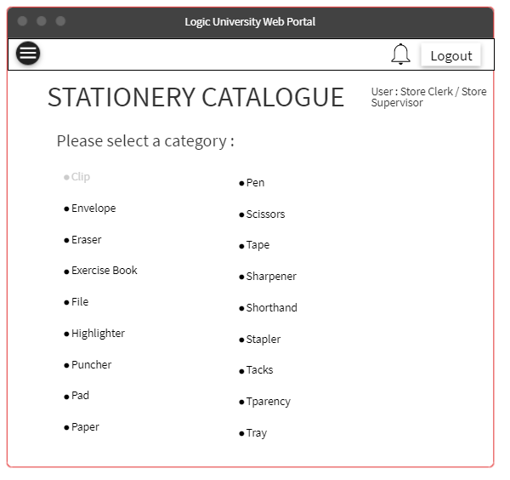
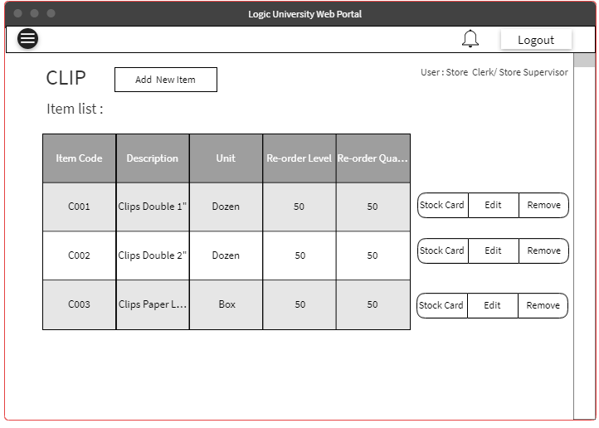
Stationery Catalogue for Store
Notes:
This is stationery page for store (so store clerk can edit the details) and access the stock card

Slide 7
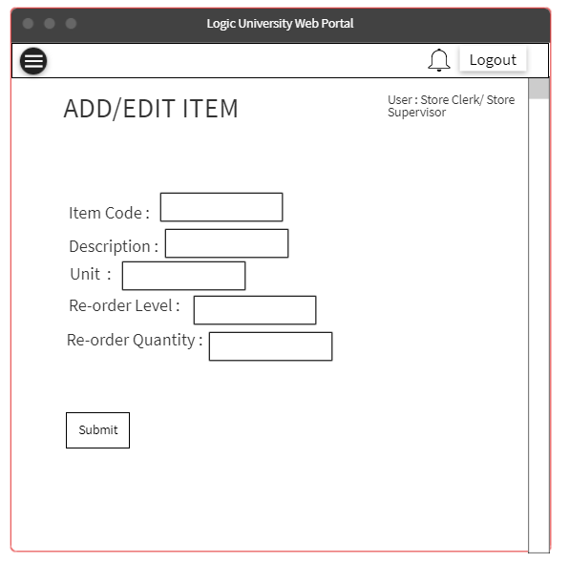
Edit Stationery Catalogue
Features/Business Workflow :
In stationery catalogue for store department, Store clerk and Store Supervisor will be able to select the stationery category and make changes.
1. Select stationery catalogue.
2. Choose the stationery category (Clip, pen , paper, etc).
3. Store Clerk or Store Supervisor will be able to see the description, unit, reorder level and reorder quantity.
4. In addition, he will be able to add, edit and remove the component of an item, whenever required.

Slide 8
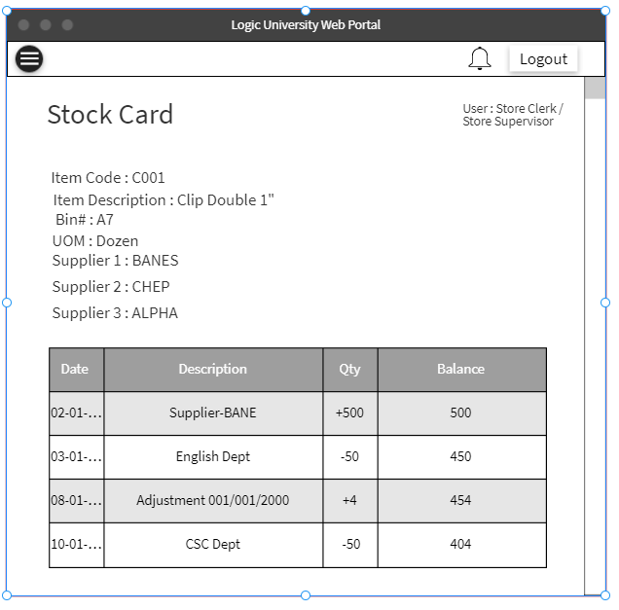
Stock Card
Features/Business Workflow :
All the transaction list or movement for a particular item will be recorded automatically in their own stock card. In addition, stock card will also include list of suppliers who supply this item.
1. Select stationery catalog.
2. Choose the stationery category (Clip, pen , paper, etc).
3. Store supervisor will be able to see the re-order level, reorder quantity and the price of that particular item and also, there will be a button that leads to this stock card.

Slide 9
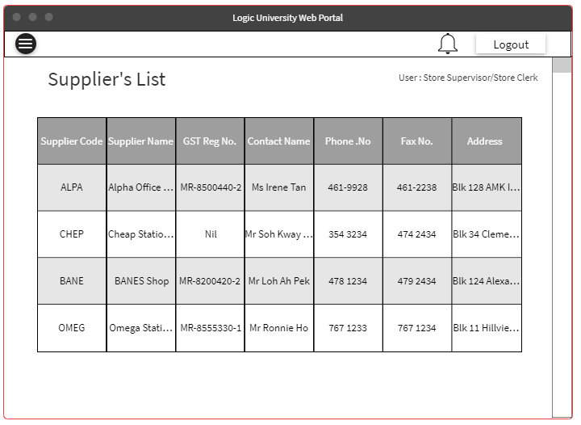
Supplier List (for Store Clerk and Store Supervisor)
Features/Business Workflow :
The store clerk and store supervisor will be able to view the supplier’s list
1. Select the supplier's list.
2. It will display the list of items supplied by that supplier.
Notes:
Delete button ‘items supplied’
No more items supplied page

Slide 10
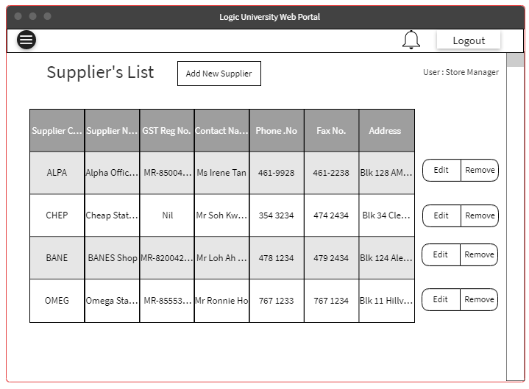
Supplier List (for Store Manager)
Notes:
Delete button ‘items supplied’

Slide 11
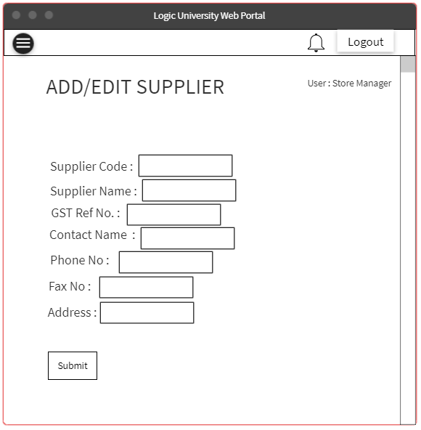
Supplier List (for Store Manager)
Features/Business Workflow :
The Store Manager will be able to view,edit and remove supplier in the Supplier list, because they have the information from the Purchasing Department on which supplier win the tender. In addition, they will be able to add or edit the item supplied by the supplier.
1. Select the supplier list
2. Click on the add supplier/edit button to add/edit supplier's details, remove button to remove suppliers, and item supplied button to view list of items supplied by this particular supplier. (Assumption : 1 supplier can supply many items, but 1 particular item can only supply by one supplier)
3. Fill in the required details for each of the edit page.
Notes:
Delete both screens.

Slide 12
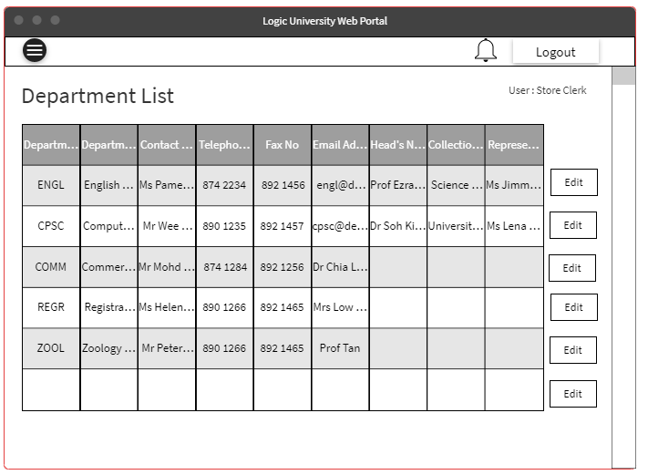
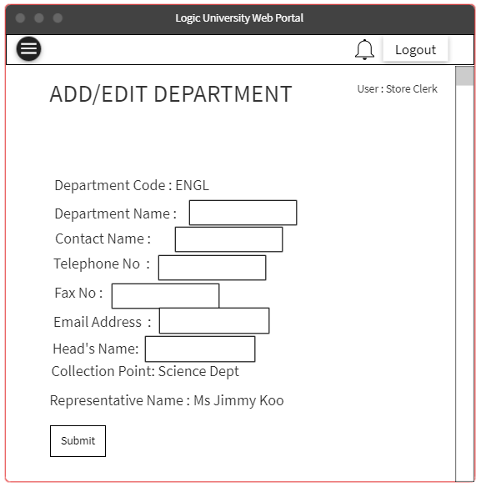
Department List (for Store Clerk)
Features/Business Workflow :
The Store Clerk will be able to view the department's list and edit the details .
1. Select the department's list, so store clerk will be able to know the location and the representative name to distributed the items to.
2. Click on the edit button to edit the department details .
3. Fill in the required details for each of the edit page. (Note that Store clerk cannot edit the department code, head’s name, collection point and representative name. It can only be done from the department side).

Slide 13
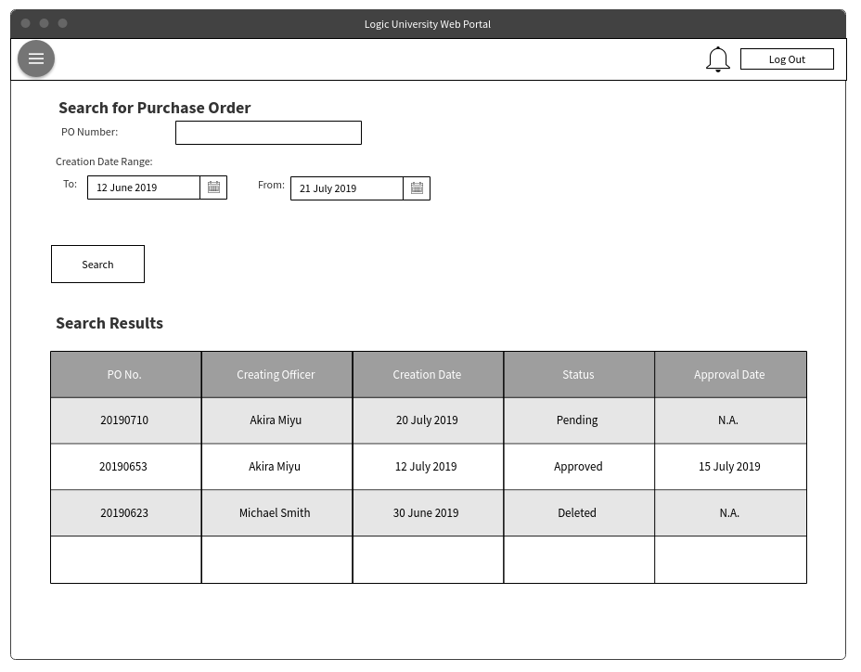
Search for Purchase Order Page
Features/Business Workflow :
On entering the Purchase Order screen, the user can opt to search for a PO previously created
1. Search by the PO number or by the date created.
2. Clicking on any of the PO number links will bring them to the detailed PO view.
3. The store supervisor can also use this menu to look for the PO’s to approve.

Slide 14
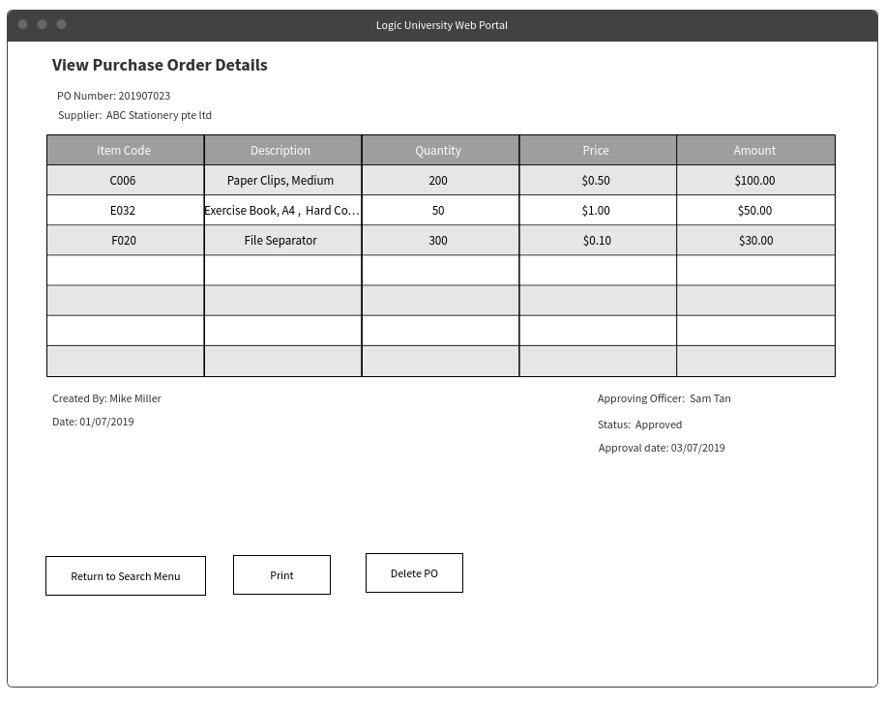
Detailed PO view Page
Features/Business Workflow :
This is the screen shown when entering the detailed PO view
1. PO can be printed and sent to suppliers
2. As long as the PO has not been approved, the creator(only) can choose to delete the PO.
3. In the event where supplier cannot supply the items, a deletion of PO also requires the supervisor’s approval (email to supervisor to be sent separately)

Slide 15
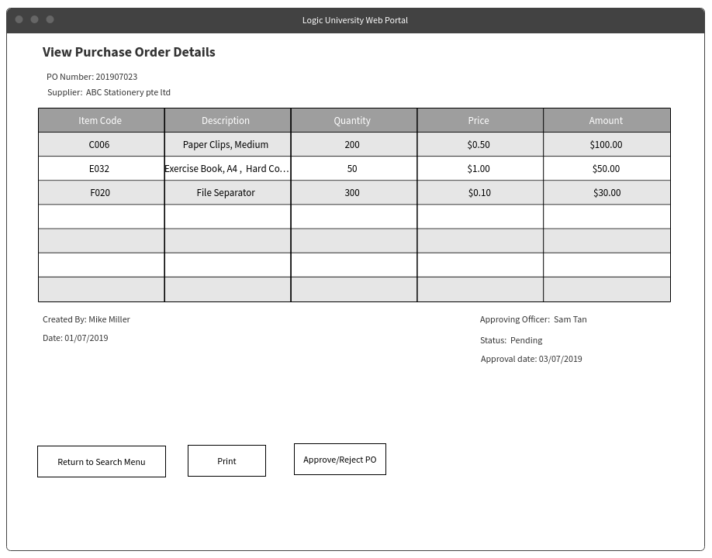
Detailed PO view Page
Features/Business Workflow :
This is the Detailed view page from the supervisor’s point of view.
Note that the delete button has changed to an approve/reject PO button.

Slide 16
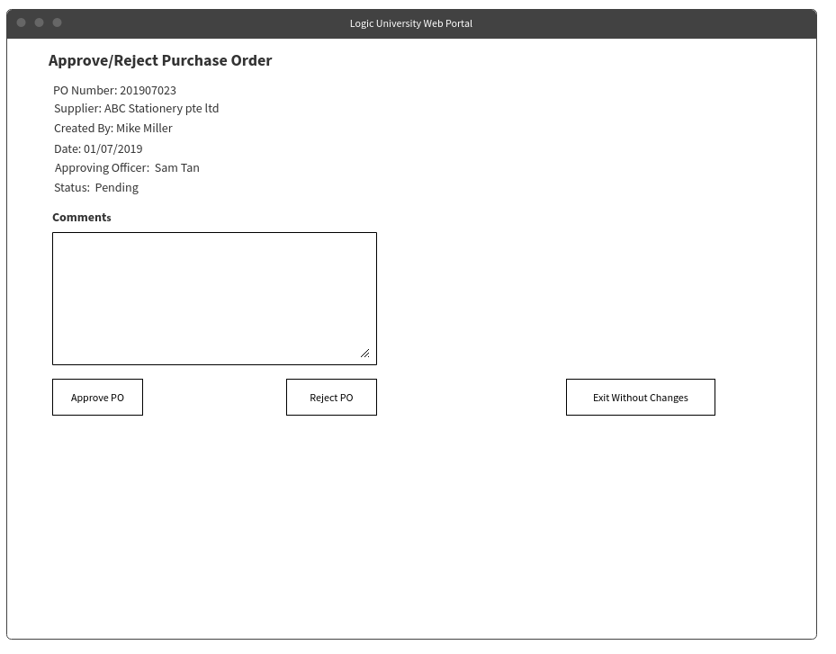
Approve/Reject/Cancel PO view Page
Features/Business Workflow :
This is the screen for approving/rejecting PO’s, as well as cancelling PO’s which have already been approved.
On rejection of PO, it will be necessary to provide the reason for rejection or cancellation in the comments.

Slide 17
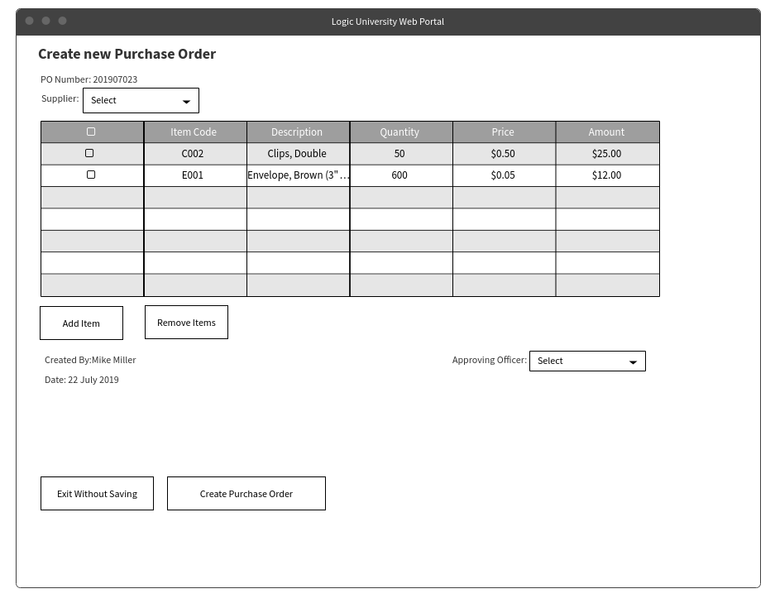
Purchase Order Creation Page
Features/Business Workflow :
On selecting the create Purchase order function, this is the screen the user will see
1. PO number will be auto-generated upon creating the PO for approval
2. Clicking on add-item generates a pop-up showing a searchable catalogue
3. Only the Item Code and quantity can be edited (the rest of the fields are auto-populated upon confirmation of Item Code)
3. Removing items is done by selecting the checkbox and clicking the remove items button
Notes:
Delete 'Approving Officer’

Slide 18
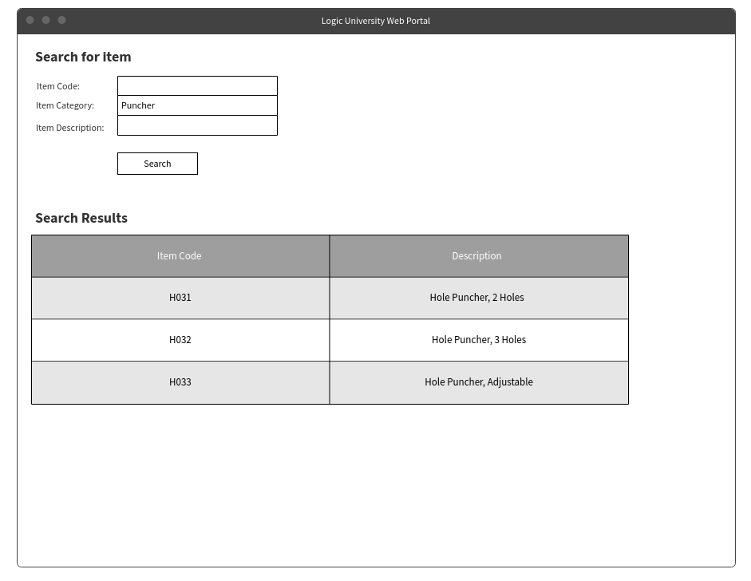
Search for Item Page
Features/Business Workflow :
This is an example of the item pop-up that can be used to search for items.
The user enters the criteria here to search for the item code for the necessary items

Slide 19
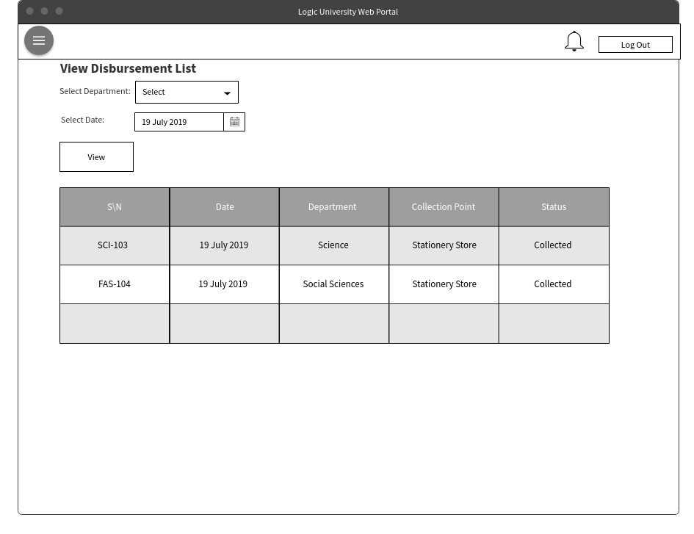
View Disbursement List Page
Features/Business Workflow :
On selection of the disbursement list function, the user is taken to screen where they can search for them.
1. After setting criteria and selecting the view button, a list of disbursement lists is generated.
2. Clicking the Serial Number link brings the user to the respective detailed disbursement list

Slide 20
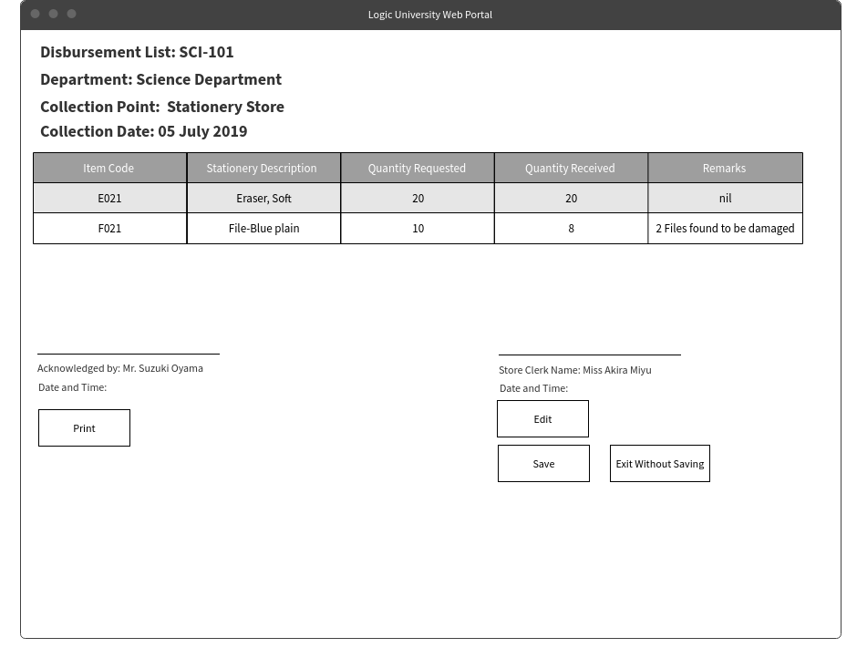
Disbursement List Details Page
Features/Business Workflow :
This is the screen where the detailed disbursement list can be found.
The original list is partially auto-generated, by drawing data from the consolidated order list from each department, but can cater for edits (for example, in the event some items are faulty).
Store staff is to bring the 2 draft hard copy for signing for the dept representative.
Edits can only be done on the store side, and only on the Quantity Received field and the Remarks. The edits have to be made according to the hard copy printed.
Once fields are complete, form is saved finally. The form will no longer be editable after that

Slide 21
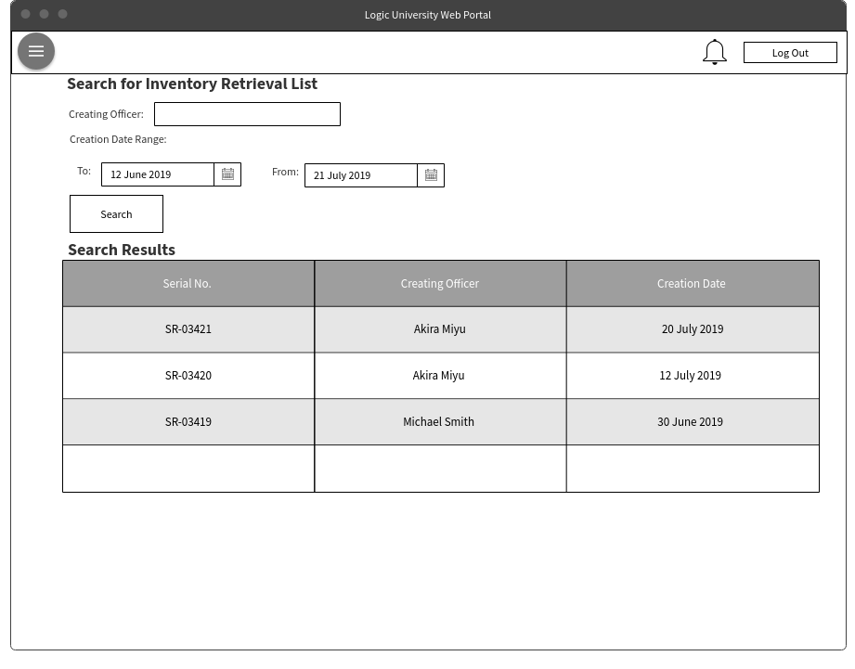
Search Inventory Retrieval Forms Page
Features/Business Workflow :
On selection of the Inventory Retrieval list, this is the screen that appears.
After setting the search criteria, a list of results is returned to the user.
Clicking on the links will bring the user to the detailed view

Slide 22
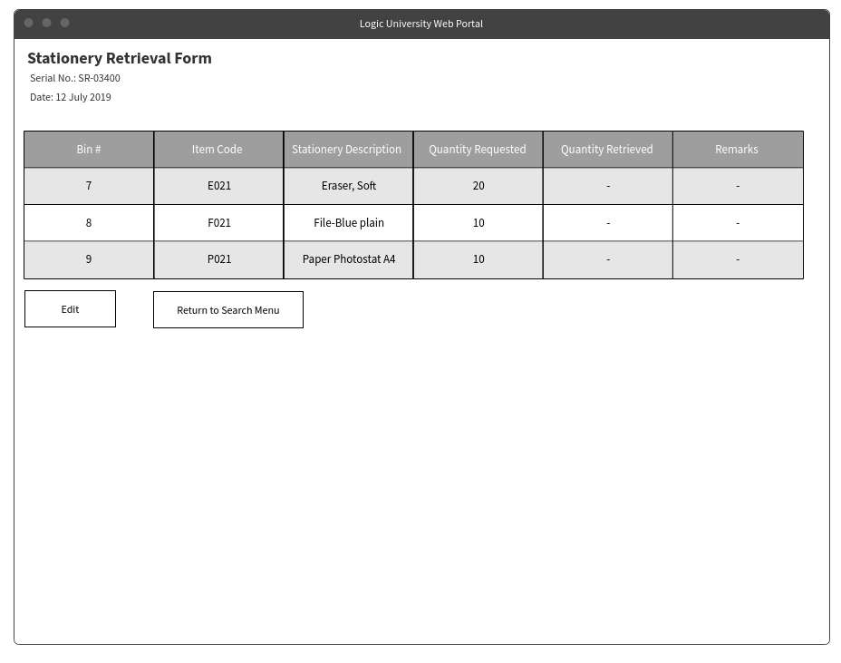
Detailed Inventory Retrieval Form Page
Features/Business Workflow :
This is an example of the detailed view of the stationery retrieval form. Some of the fields are automatically populated.
Fields such as Item code, Bin number(#) description are populated based on the items.
Quantity requested is derived from the consolidated orders list.
It allows users the option to navigate back to the previous menu, or to edit the inventory retrieval list (Necessary when editing the actual quantity retrieved, remarks etc.)

Slide 23
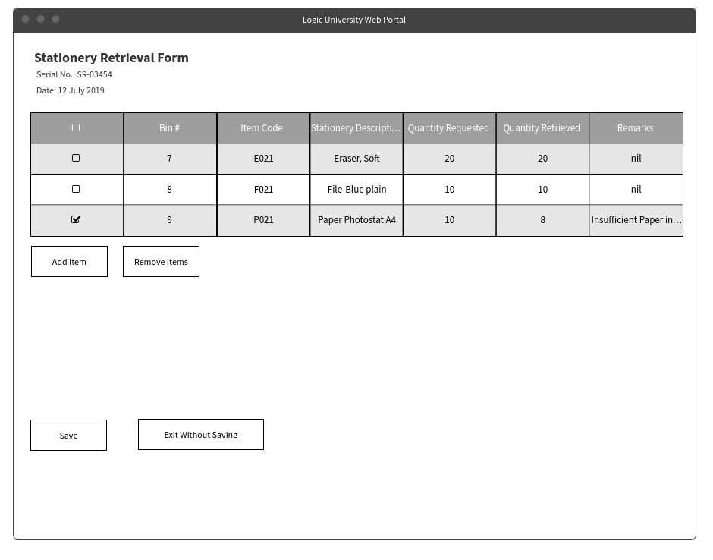
Edit Retrieval Form Page
Features/Business Workflow :
On choosing to create/edit the retrieval form, this page is shown.
Fields that are editable are the Item code and Quantity retrieved. The rest (such as description) will be auto generated
The add item function and remove item function was described earlier.
On saving, the quantity withdrawn will be reflected as a transaction in the stock card.
On saving, this form is no longer editable.

Slide 24
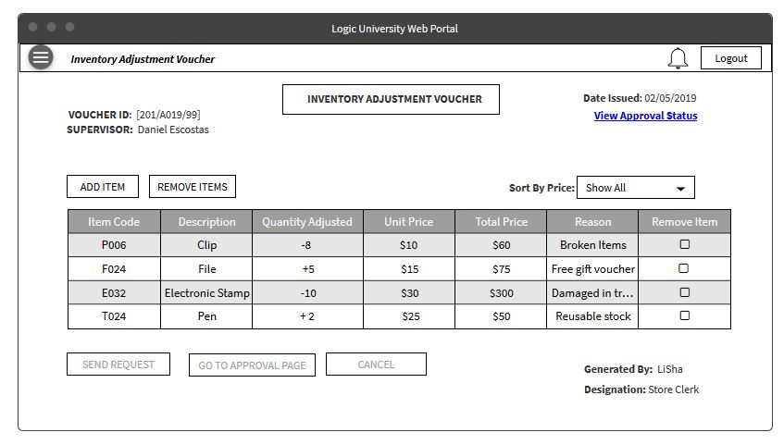
INVENTORY ADJUSTMENT VOUCHER
Features:
Unique Voucher ID.
Sort items by Price
ADD button to add a new item to the voucher.
Send request button filters the request based on total price
Allows the option to remove an item from the list.
Hyperlink to access the Approval Status page.
Go to Approval button to navigate to the Approval page.

Slide 25
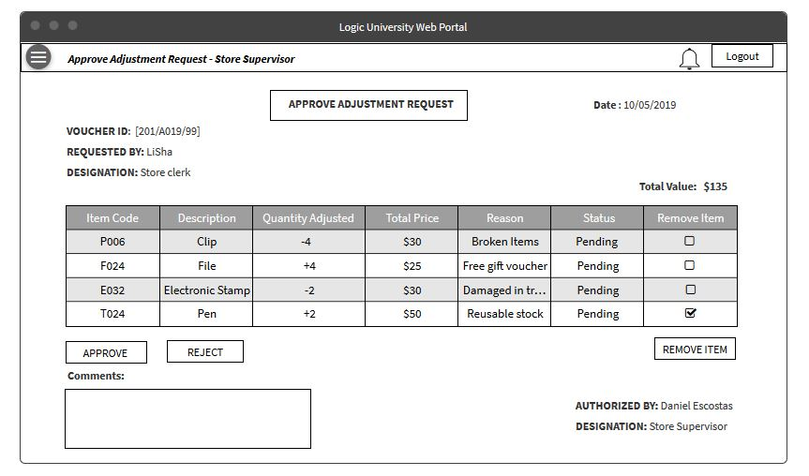
APPROVE ADJUSTMENT REQUEST - STORE SUPERVISOR
Features:
Approve/Reject buttons for the user.
Remove item checkbox to remove any unneeded items.
Comments box to provide any comments
Total price display at the top of the table.
Displays only items with total price less than $250
Status displays the current approval status of the item.
The user can electronically sign at the bottom to authorize the document.
Notes:
Delete ‘remove item’ button

Slide 26
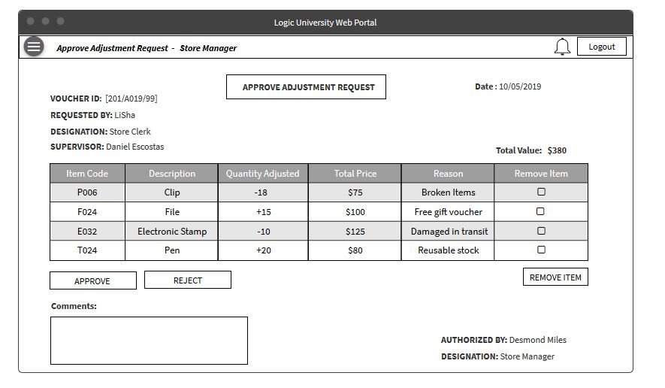
APPROVE ADJUSTMENT REQUEST - STORE MANAGER
Features:
Approve/Reject buttons for the user.
Remove item checkbox to remove any unneeded items.
Comments box to provide any comments
Total price display at the top of the table.
Displays only items with total price more than $250
The user can digitally sign to authorize the document.
Displays the Supervisor/ Clerk details at the top.
Notes:
Delete ‘remove item’ button

Slide 27
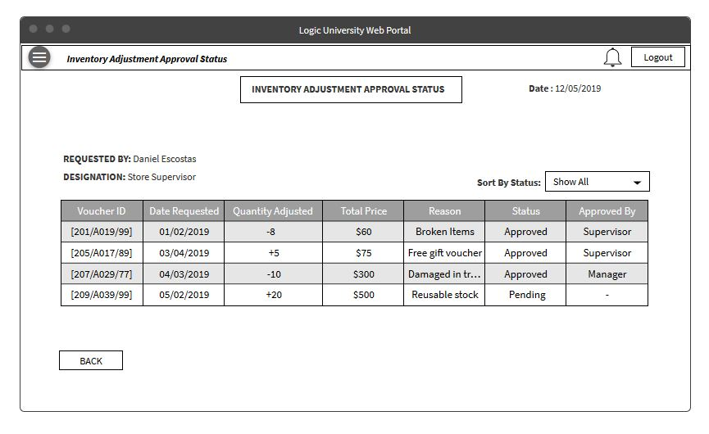
INVENTORY ADJUSTMENT APPROVAL STATUS
Features:
Displays the Approval status of the Voucher.
Displays the designation of the person approving it.
Sort by Status to view only Approved or pending vouchers
Displays the date request was made
Displays the total purchase value.

Slide 28
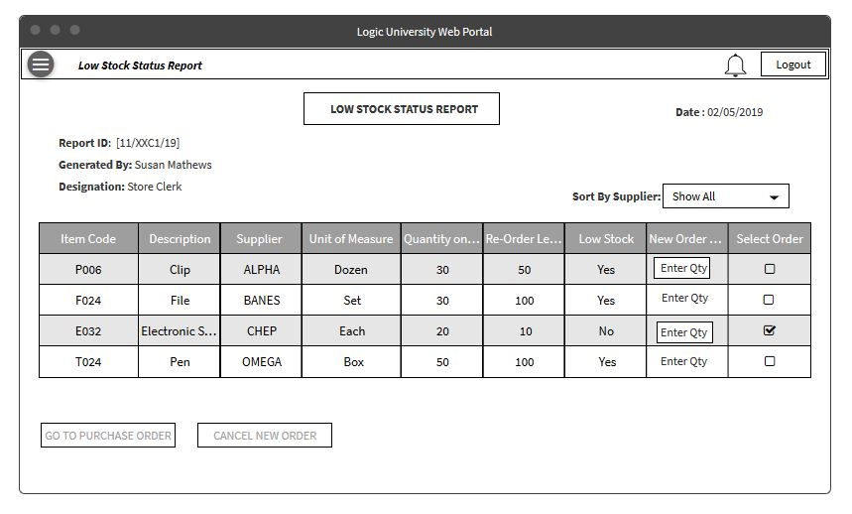
LOW STOCK STATUS REPORT
Features:
User can view the items low in stock
User can enter the quantity of items to be ordered.
User can select individual orders by enabling the checkbox.
Allows to send the items to the purchase order form.
Allows to filter by Supplier name
Notes:
Note : No need to enter qty in this report

Slide 29
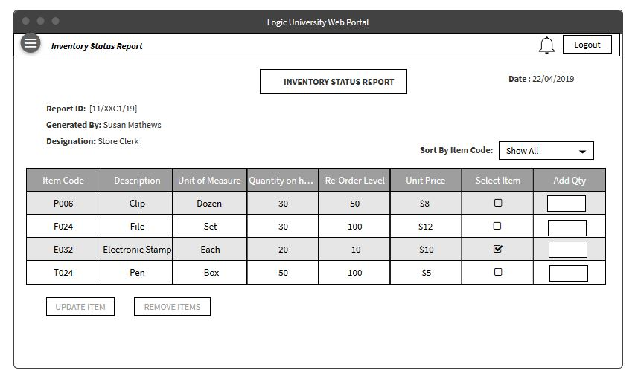
INVENTORY STATUS REPORT
Features:
User can view the list of inventory items.
User can add quantity to update the item quantity.
Allows the user to select individual items.
Update/Remove buttons based on the selection made.
Update item takes the user to the transaction history pop-up screen.

Slide 30
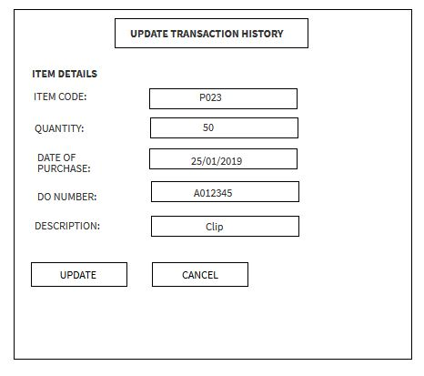
UPDATE TRANSACTION HISTORY
Features:
This screen displays the consolidated item information to the user.
User can edit the quantity and other related fields for any corrections.
User can key in the DO number and update the transaction history from this screen.
Notes:
Noted : Instead of using DO number, we use PO number.

Slide 31
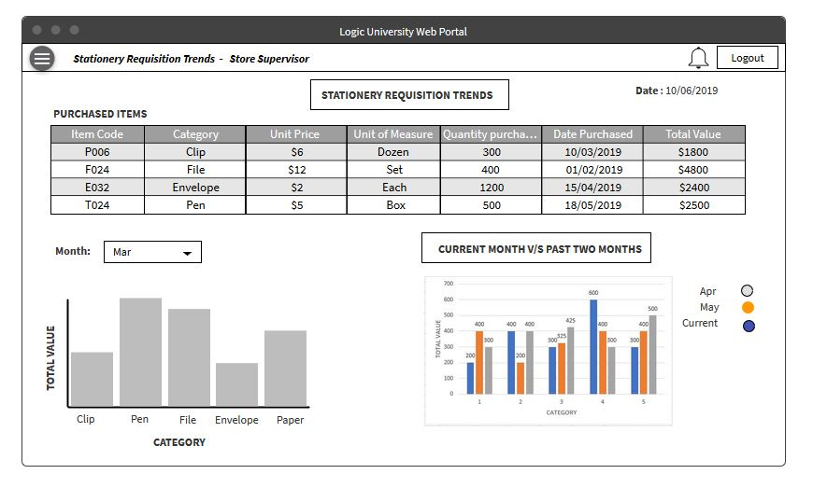
STATIONERY REQUISITION TRENDS
Features:
User can view the purchased items list with the total value.
Select month to view the chart for each category of items.
Comparing the trend of the current and past two months using histogram charts.
X-axis represents the Category of item.
Y-axis represents the total purchased value.
Notes:
Wants to be able to see the future amount based on the previous months orders
Use past to predict the future

Slide 32
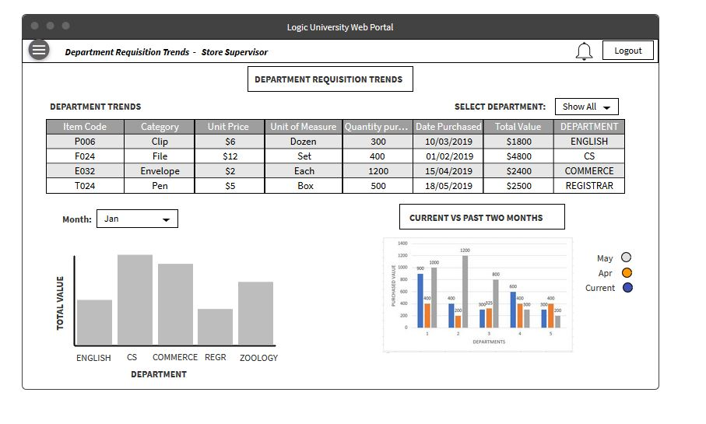
DEPARTMENT REQUISITION TRENDS
Features:
User can view the department trends and total purchased value a table format.
Filter by individual departments
Allows the user to select a trend for a particular month
Comparing the trend of the current and the past two months using the histogram.
X-axis represents the individual departments
Y-axis represents the total purchased value for the month
Months are color coded in the chart.

Slide 33
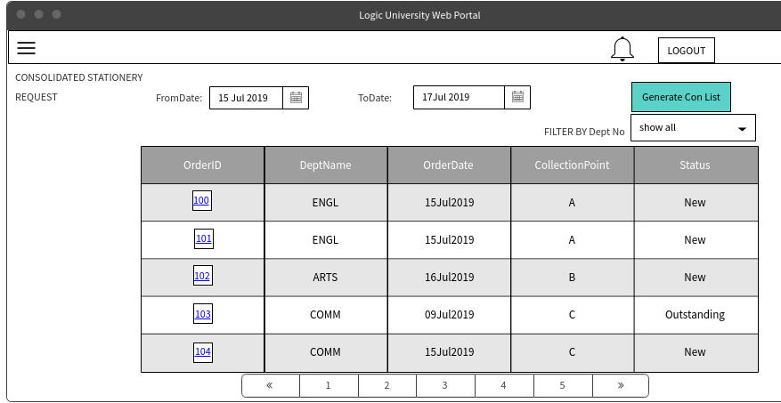
CONSOLIDATED STATIONARY REQUEST-STORE CLERK
Features:
Store Clerk can generate consolidated stationary requests for easy lookup and delivery.
Select the From date and To date and click on Generate Button
This will get all the New requests and also Outstanding deliveries which are pending from last week because of no stock are also displayed.
Store Clerk can click on the order link to view the order details

Slide 34
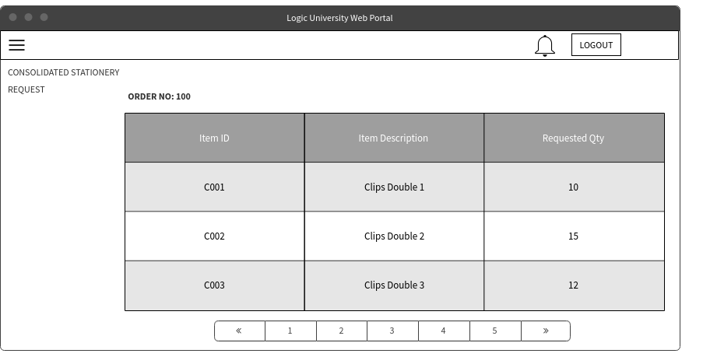
CONSOLIDATED STATIONARY REQUEST-STORE CLERK
Features:
Store Clerk can view the details of each delivery.

